Slide 1
RTM AND TESTCASE PREPARATION

Slide 2
What you will come across in this session
Requirement Traceability Matrix (RTM)
Importance of RTM
Practical Exercise
Queries

Slide 3
Requirement Traceability Matrix(RTM)
Requirements tracing is the process of documenting the links between the user requirements for the system you're building and the work products developed to implement and verify those requirements.
Business Scenario's are defined as per the Requirements & Acceptance Criteria.
The Test cases are drafted as per the Requirements / Acceptance Criteria / Business Scenario.
The Requirements are mapped to the Test cases in the RTM.
User Story/BRS

Slide 4
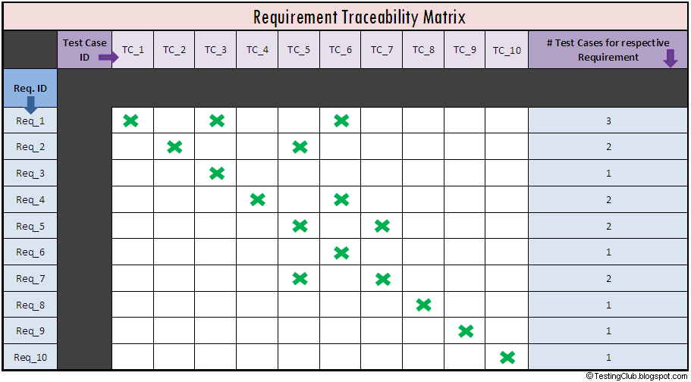

Slide 5
Practical Exercise
Go through the website www.gmail.com.
Prepare the sample RTM for Sign Up & Login Page.
Send it across to mabraham@suyati.com with your name.

Slide 6

Queries

